Slide 1
UNIFIER IN ACTION
ENTERPRISE IMAGING USE CASES AND CASE STUDIES

Slide 2
In 2008, Dicom Systems started with the idea to design a high-performing "Cisco router for Imaging" that could power fast, efficient and scalable teleradiology workflows in high latency, low bandwidth environments.
From its beginning as an authority on DICOM routing, the company's vision has evolved with the launch of Unifier, an Enterprise Imaging platform with solutions for interoperability, workflow, archiving, cloud and AI on-ramp. Today, Unifier has been deployed to hundreds of sites with 8 billion images being routed through the platform annually. Technology and customer service from Dicom Systems has garnered recognition by RSNA Image Share Validation for IHE conformance, HIMSS Interoperability Showcase, and Google Cloud Partner Awards for 2017 Innovative Solution in Health Care. Proven at worldwide deployments, Dicom Systems is preferred by top healthcare enterprises, government agencies and integration partners for next-generation Enterprise Imaging.

Slide 3
UNIFIER IN ACTION
ENTERPRISE IMAGING USE CASES AND CASE STUDIES

Slide 4
Content
Understand some of the ways in which Unifier is implemented to solve common enterprise imaging challenges
2 |
4 |
6 |
8 |
10|
Use Cases
HL7 Integration
Load Balancer
Vendor Neutral Archive
De-Identification for AI
Clinical Workflows in the Cloud
12 |
13 |
14 |
15 |
16 |
Case Studies
Intelligent Routing
Visible Light Imaging & Clinical Collaboration
Relevant Priors
Enterprise Integration
AI/Machine Learning

Slide 5
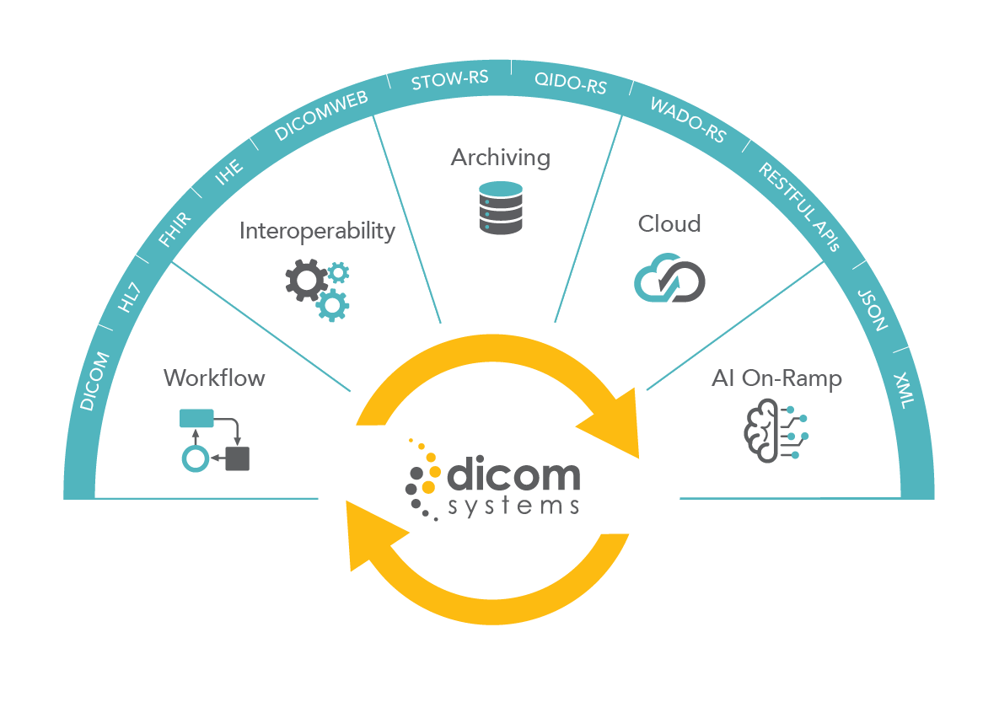
Meet Unifier
Unifier by Dicom Systems is an Enterprise Imaging platform that enables intelligent workflow and communication between disparate imaging systems and equipment, and provides a scalable and reliable engine to transform and efficiently manage image data.
1

Slide 6
HL7 INTEGRATION
Enable interoperability between diverse information systems
Challenges
The exchange of data between new and old systems, modalities and sites does not happen out of the box. Common challenges include modality-level integrations to support sending to PACS or VNA, distributed points of failure, and a rampant need for tag morphing to ensure data transmission does not fail due to unsupported DICOM elements. Individual HL7 interfaces are costly and time-consuming to establish and maintain. Manual workarounds are not scalable and create complexity With Unifier, an organization can enable any systems to connect and communicate with logic and intelligence. Its HL7 integration feature eradicates risky point-to-point solutions creating a resilient infrastructure. All connections to and from a PACS, VNA and modalities can be managed through a single interface. Unifier enables organizations to create a centralized destination for outside facilities to send exams and easily modify the metadata.
Eliminate custom HL7 interfaces which are costly to implement and maintain
Easily support new and legacy imaging modalities and systems
Quickly establish interoperable image transfer workflows with new sites
Avoid costly and time - consuming upgrades
that will inevitably complicate matters in the future.
2

Slide 7
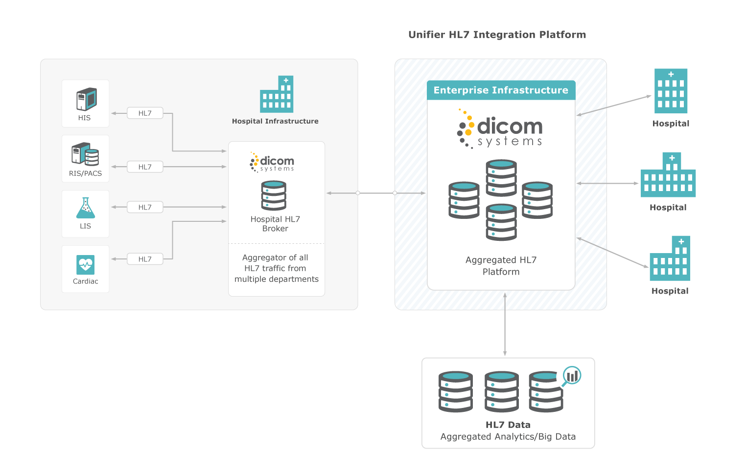
Built-in Enterprise DMWL
Great for multiple locations
Save on custom HL7 interfaces
3

Slide 8
LOAD BALANCER
Optimize imaging traffic on your network
The flow of DICOM data within and across a healthcare network is dependent on a variety of variables. The performance of servers, time of day, size of data files and available network bandwidth can all impact how quickly a study moves between modalities, archives and workstations. The urgency of emergent studies, workflow needs of various specialties, and service level agreements with both internal and external constituencies can be drivers for exercising more control over data traffic. Load balancing technology specifically designed for DICOM data gives imaging IT departments full control over how resources can be efficiently used in the transmission and storage of these large datasets.
With Unifier, an enterprise can intelligently and proactively balance the transmission of data to and from any system. Load balancing rules customized to specific preferences and needs can contribute to delivering timely, high quality care to patients while also optimizing IT resources, application delivery, and overall scalability.
Ensure the uptime of imaging workflows and resiliency of the network
Support critical and emergent care by expediting relate imaging data
Maximize IT resources by providing a way to easily share the load across multiple servers when archiving
4

Slide 9
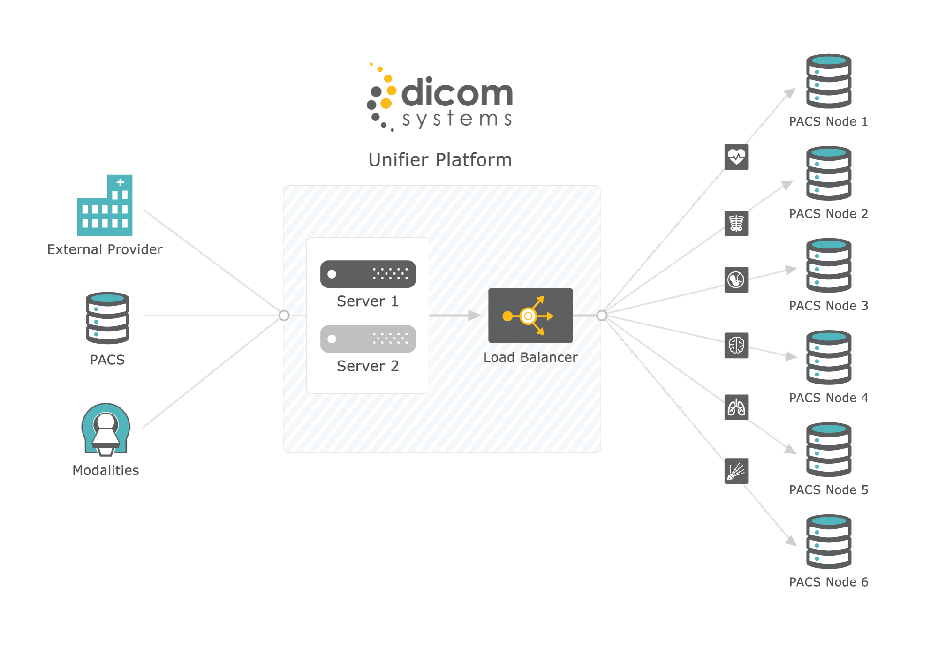
Full configuration for
faster application delivery
Pre-built, easy to use
templates
Accurate, updated health
checks
5

Slide 10
VENDOR NEUTRAL ARCHIVE
Integrate all of your enterprise imaging data
More clinical specialties across the health system are capturing patient imaging. In some cases, this has led to new, departmental data silos which can impact patient care and safety because important clinical information may not be easily accessible to all care providers. Additionally, supporting and maintaining multiple archives can be taxing for the IT department. A vendor neutral archive (VNA) can work behind the scenes to help your organization standardize data and images from any source into a single destination so that it can be seamlessly accessed by all care providers, regardless of their location or specialty. A VNA enables efficient and secure access to all imaging exams for radiologists, cardiologists and other physicians whether for primary reading or review.
Unifier Archive provides enterprise-wide access to all imaging data with flexible deployment options and a cost-effective fee structure. Its scalable, standards-based foundation ensures it can support your organization as archiving needs increase and evolve.
Centralize and consolidate all enterprise imaging workflows
Ensure image data is universally available to care providers
Maintain seamless patient care workflows even if image data is in transit or being migrated
6

Slide 11
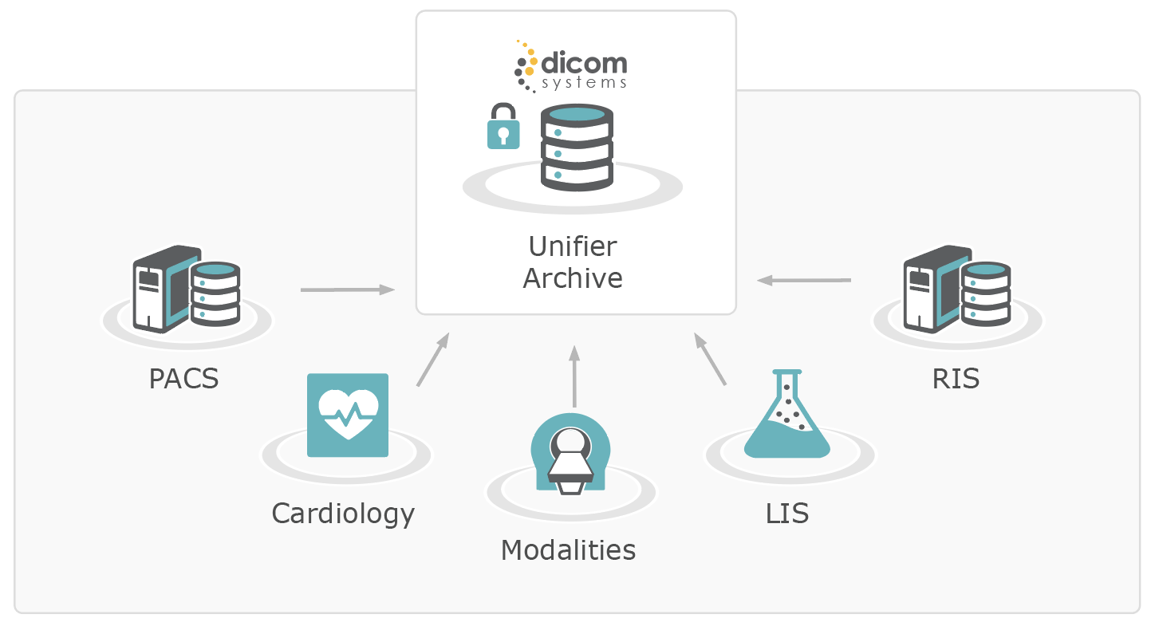
360° view of Healthcare
Protect data long-term
100% vendor neutral
7

Slide 12
DE-IDENTIFICATION FOR AI
Prepare your data for research, machine learning and clinical trials
Healthcare is leading the adoption and application of artificial intelligence related initiatives, and medical imaging is at the forefront of that wave. Radiology departments govern stores of valuable clinical data that represent largely untapped opportunities for therapeutic advances, as well as cost savings that can come from making care delivery more accurate and efficient. There is a lot of support for leveraging imaging data for machine learning projects, especially for training AI solutions. At most organizations there are not enough resources to undertake de-identification
Unifier provides unparalleled tools to remove protected health information (PHI) from DICOM metadata and pixels as well as HL7 result messages at a large scale. This feature includes QA functions to ensure data is fully de-identified prior to being shared with an outside party. As the originating data provider, your organization has exclusive access to keys and methods to re-identify data.
Prepare your organization’s data for sharing with outside entities
Make your data more appealing to commercial partners by demonstrating superior quality
Preserve patient privacy and data integrity and adhere to HIPAA privacy rules all while contributing to innovation in medicine
8

Slide 13
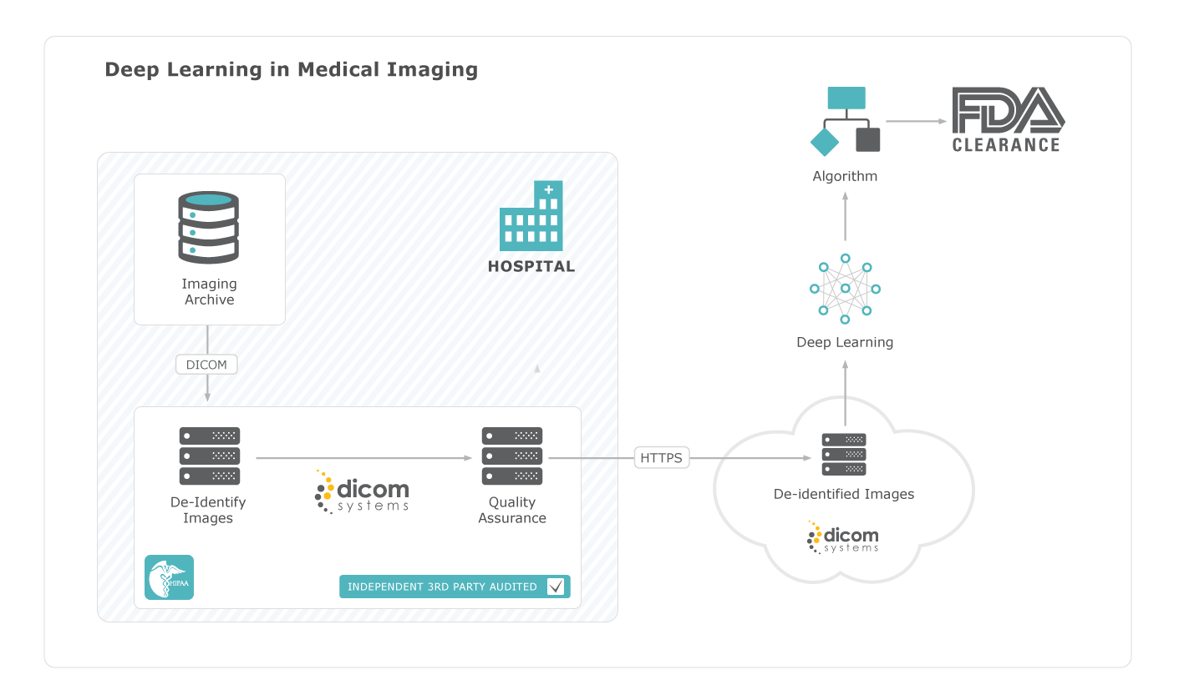
HIPAA compliant
Complete framework from data
migration to building a data lake
QA features verify
completion
9

Slide 14
CLINICAL WORKFLOWS IN THE CLOUD
Virtualize and scale your enterprise imaging infrastructure
Growth in imaging procedure volume and data set size as well as evolving datasets that now include visible light and other non-traditional imaging studies have made the ongoing management of a flexible and scalable enterprise imaging infrastructure costly and challenging. For both large and small organizations, the costs related to standing up an imaging infrastructure can be too unpredictable or require large upfront investments. IT departments are also already saddled with too many projects and limited resources so investments in storage and hardware can be difficult to justify. With a cloud-based imaging ecosystem organizations can more efficiently scale applications, storage and data accessibility, which can help keep overhead costs low even when expanding.
Dicom Systems has established partnerships with leading cloud providers. Unifier can be deployed on any cloud provider for seamless access to all of its enterprise imaging features.
Upgrade your imaging workflows without forklift upgrades
Leverage the features of Unifier within minutes
Throttle the computing power and storage capacity as needed
Minimize upfront costs with a SaaS payment model
10

Slide 15
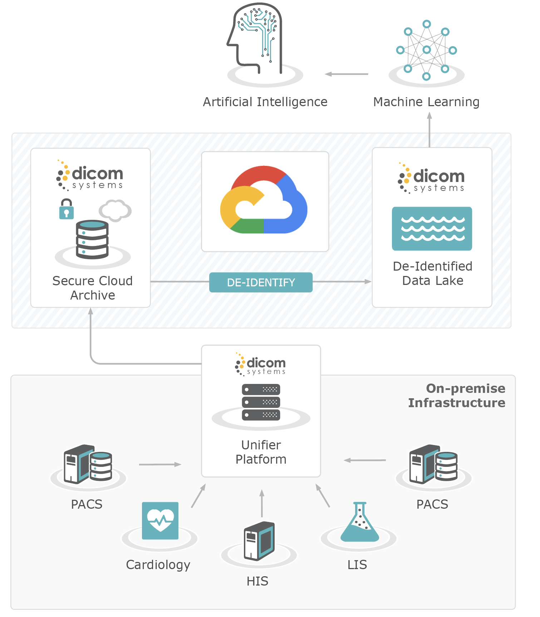
Secure healthcare cloud
Centralize systems
Easy Scalability
11

Slide 16
80-90% automatic matching
of inbound studies
Southern California Permanente Medical Group accelerates imaging operations for 14 hospitals and 100+ clinics
Intelligent data routing across an expansive healthcare enterprise
Strategy
Active and passive instances of Unifier at each hospital to ensure high availability of routing capabilities. Centrally managed libraries of routing logic via LUA scripting so that updates are instantly deployed across the enterprise.
Improved management of 2,500+ modalities
Accelerated data ingestion at new and existing sites
Unifier Features Stack
Intelligent routing, DMWL, Tag Morphing, Bi-directional HL7 Routing, High Availability Auto-Failover, LUA Scripting Framework
“The Unifier platform has enabled SCPMG to easily manage a large number of DICOM routers. We can maximize functionality and update the business logic of over 2,500 modalities in our network.”
- Bruce W. Hoel, Imaging Solutions Architect, SCPMG
12

Slide 17
Save ~20 minutes per case with point-of-care image capture
Nationally ranked pediatric facility with more than 440,000 outpatient visits and 168,000 imaging studies performed each year.
Intuitive workflow for capturing & collaborating on visible light imaging
Strategy
Unifier integrated with WinguMD for phased rollout of specific pathologies with customized workflows for specialists. Replaced SLR cameras with hospital- sanctioned mobile devices that auto-sync data. All data and non-DICOM imaging captured in EHR and PACS.
Unifier Features Stack
Intelligent routing, DMWL, Bi-directional HL7 Routing, Integration with ZenSnap by WinguMD for clinical communication, collaboration and visible light imaging.
Reduced manual errors,
pulls up
patient EHR
Improved department-wide communication
“Nicklaus Children’s Hospital is excited about the communication tools and interdisciplinary collaboration provided by WinguMD and Dicom Systems. Prior to deploying the application, clinical photos were stored in multiple devices using numerous manual processes. These companies have provided us with a single and seamless solution for clinical photos that answers the needs of our care teams.”
- Elise Hermes, Chief Nursing Information Officer, Nicklaus Children’s Health System
13

Slide 18
150% growth scaling from 650k to 1.5 million studies read per year
Foundation Radiology serves 40+ sites is the first, multi-institutional radiology group accredited by the Joint Commission.
Adopted Unifier for automatic routing and complex pre-fetching of
relevant priors
Strategy
Rolled out Unifier as the hub in its teleradiology network to receive exams from all image acquisition sources and route results back. Optimized routing workflows and triggers based on source, time and study type.
Unifier Features Stack
Intelligent routing, DMWL, Relevant Priors, Bi-directional HL7 Routing, Rapid DICOM
Improved access to
historical
data
Accelerated site acquisition
“Our staff spends less time fixing problems—now technology does it for them.”
- Chris Radi, Senior Vice President IT, Foundation Radiology
14

Slide 19
Served as point of ingestion
for several PACS migrations
Top 10 hospital on the cutting edge of technology innovation. Manages 400+ modalities and 20-50 TB of transient data per month.
Unified Enterprise Imaging for academic and medical hospital
Strategy
Deployed multiple Unifier VMs for a centralized approach to tag morphing, ensuring data flows efficiently to any archive or downstream systems without manual intervention. Unifier also enabled intelligent workflow options for load balancing and provided an enterprise archive that supported data migrations.
Unifier Features Stack
Unifier Archive, DICOM/HL7 transformation, High Availability, DMWL, DMWL Proxy, Relevant Priors, Enterprise Viewer, Rapid DICOM
Eliminated manual steps
and minimized
number of
vendors
Decreased possibility of
single point of failure
“Without Dicom Systems, we would need an army of vendor support and analysts.”
-Trevor Walker, Principal Systems Analyst, Stanford Health Care
15

Slide 20
Landmark 5.3 million exams de-identified for radiology AI
New York-based global leader in musculoskeletal health and the leading orthopedic hospital in the U.S.
De-identification for machine learning algorithm training and research
Strategy
Dicom Systems responded to the strict adherence to privacy regulations by removing/masking PHI and securely migrating data to a petabyte data transfer solution. To further optimize data quality, the de-identified radiology studies were normalized and targeted for efficient ingestion. Secondary QA function as well as an independent third party audit served as verification of correct removal of PHI.
Unifier Features Stack
Advanced Tag Morphing with De-Identification framework
Significant reduction in time intensive
data entry
Removed technical and
compliance barriers
“We found the Dicom Systems Unifier’s de-identification capabilities to be the enterprise-class platform we needed to tackle the complexity of our requirements.”
- David King, Executive Director, HSS Global Research Institute
16

Slide 21
Visit dcmsys.com for Resources
Product Briefs
White Papers
Enterprise Imaging Playbook
Cloud Test Drives
Free DICOM Software Downloads

Slide 22
Unifier By The Numbers
The signature Enterprise Imaging platform from Dicom Systems boasts impressive numbers - placing Unifier as a best price-to-performance option for its solutions category
8 billion
5,000
5.3 million
13 million+
medical images
passing though annually
exams archived daily by U.S. Army Dental Command from over 150 army dental clinics worldwide
musculoskeletal exams de-identified using Unifier’s tag morphing module
annual teleradiology
reads

Slide 23
Learn more about Unifier by
requesting a consultation or scheduling a demo
sales@dcmsys.com | 415-684-8790
Follow us for updates

Slide 24
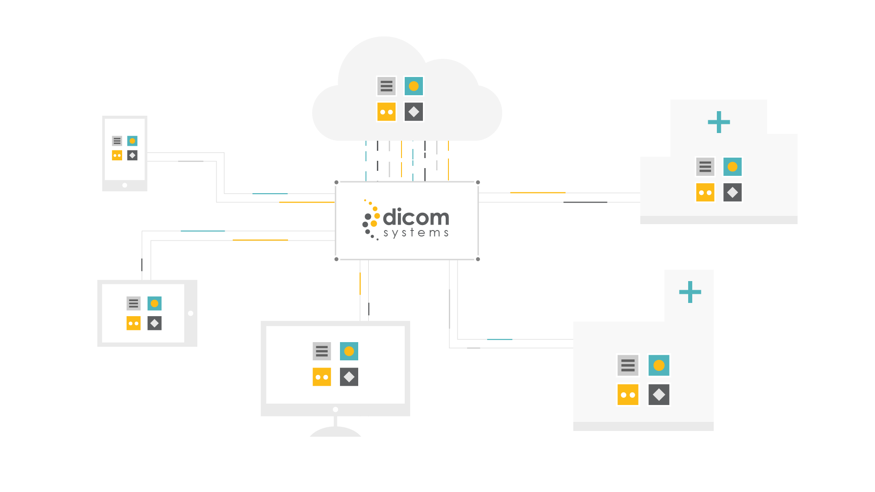
UNIFIER ENTERPRISE IMAGING PLATFORM
WORKFLOW | INTEROPERABILITY | ARCHIVING | CLOUD | AI ON-RAMP

